Slide 1
JSX Expressions

Slide 2
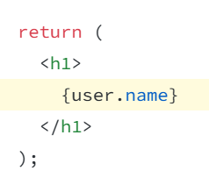
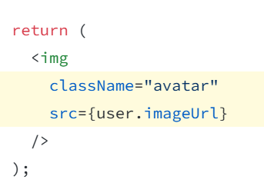
Display Data in JSX
JSX lets you put markup into JavaScript. Curly braces let you “escape back” into JavaScript so that you can embed some variable from your code and display it to the user.
You can also “escape into JavaScript” from JSX attributes, but you have to use curly braces instead of quotes.

Slide 3
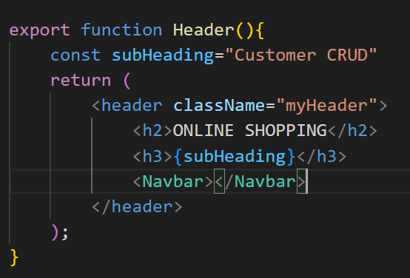
Example : adding data between tags

Slide 4
Example : adding image as data in src in attribute
Different Ways to Display Images in React.js Apps
Use the import keyword.
You can import a file right in a JavaScript module. This tells a webpack to include that file in the bundle.
Use the require keyword.
require can also be used for including audio, video or document files in your project. The most common types are .mp3, .wav, .mp4, .mov, .html and .pdf.
Import SVGs directly as a React component.
Load images directly from the network.

Slide 5
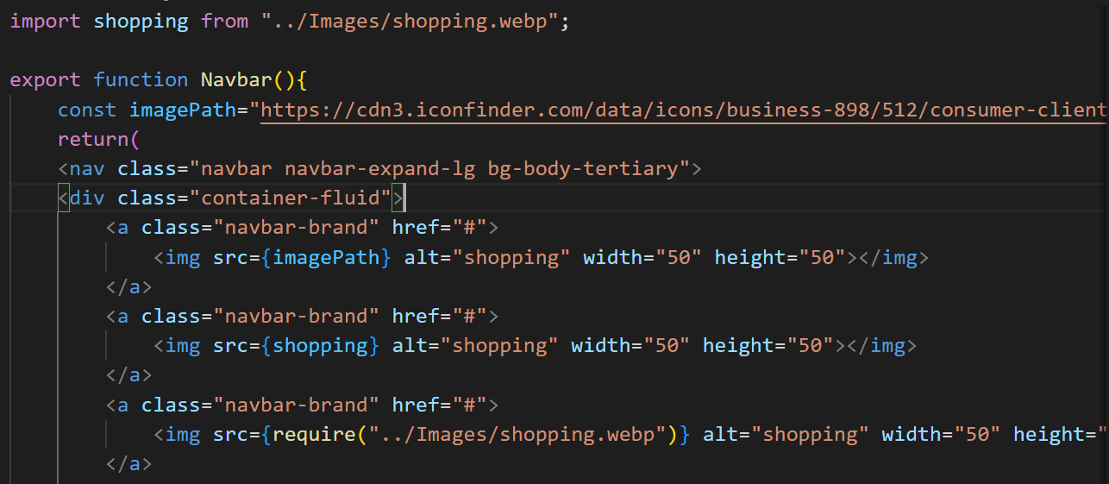
import, require, directly from network

Slide 6
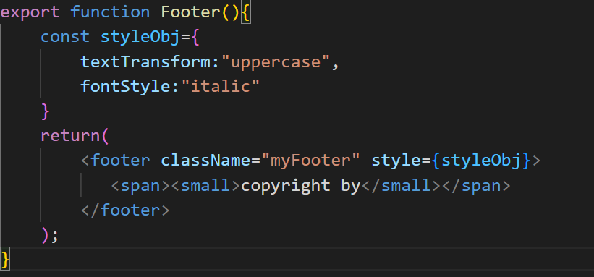
Adding style as data in style attribute

Slide 7
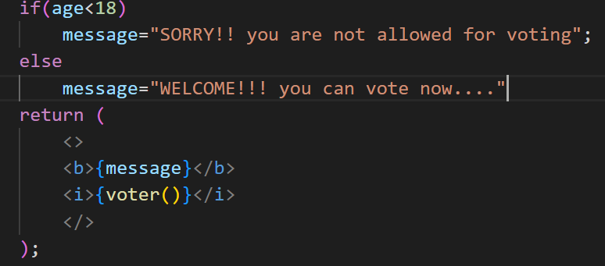
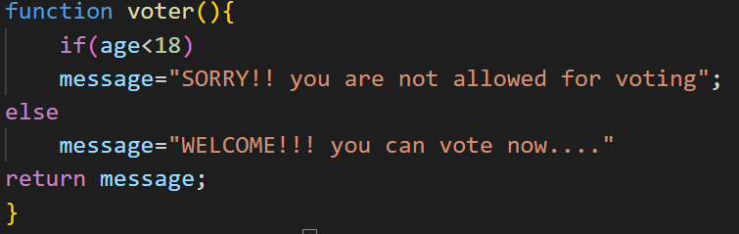
Conditional rendering: If-else

Slide 8
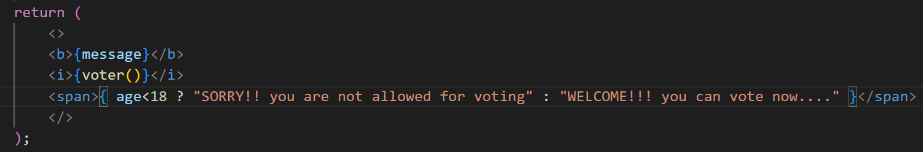
Conditional rendering: ternary operator

Slide 9
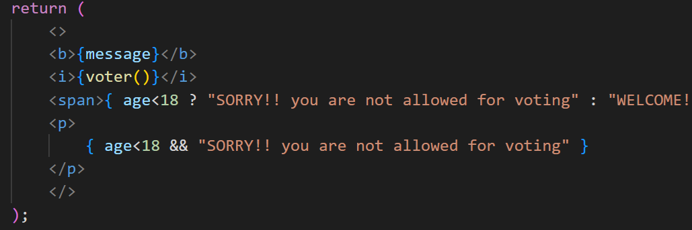
Conditional rendering: logical &&
When you don’t need the else branch, you can also use a shorter logical && syntax:

Slide 10
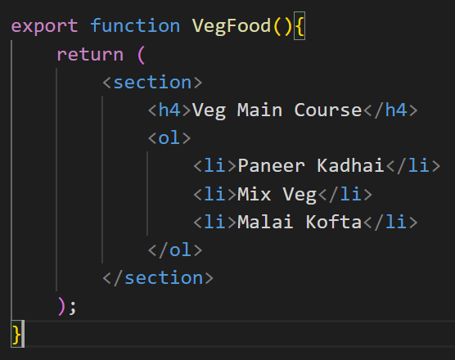
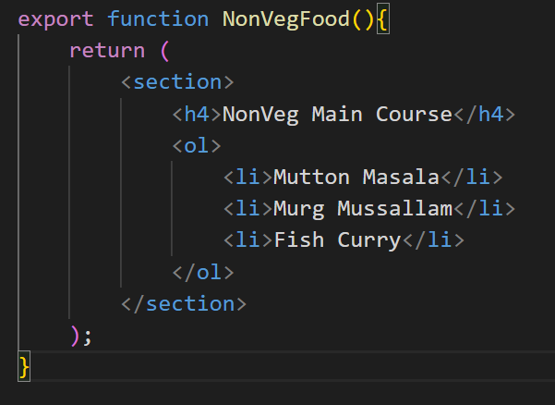
Conditional rendering : rendering components
Example : VegFoodComponent, NonvegFoodComponent
If user selects veg only VegFoodComponent must be visible
If user selects non veg only NonvegFoodComponent must be visible

Slide 11
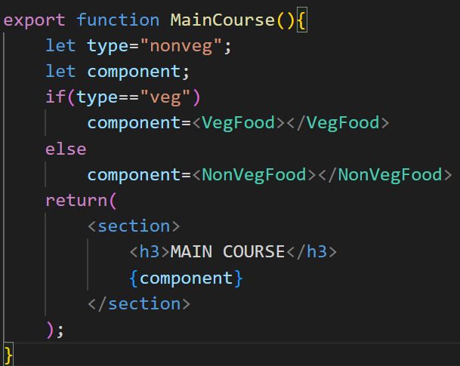
Conditional rendering : If-else

Slide 12
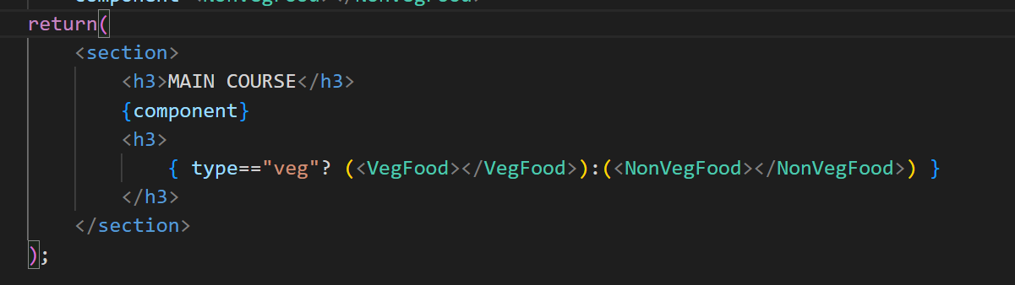
Conditional rendering : ternary op

Slide 13
Conditional rendering: logical &&

Slide 14
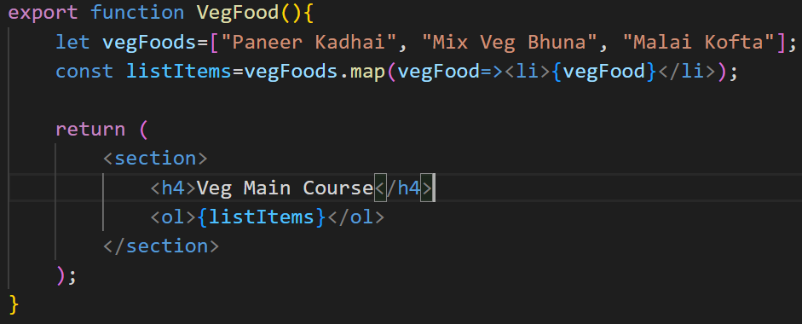
Looping
We can use JavaScript features like for loop and the array map() function to render lists of components.

Slide 15

Unique Keys to child elements
For each item in a list, you should pass a string or a number that uniquely identifies that item among its siblings. Usually, a key should be coming from your data, such as a database ID.

Slide 16
Customer Project Startup : Display Customers in table
Create Customer class and CustomerCrud model
Create Array of multiple customer objects
Create CustomerDetails Component
Display all objects in table

Slide 17
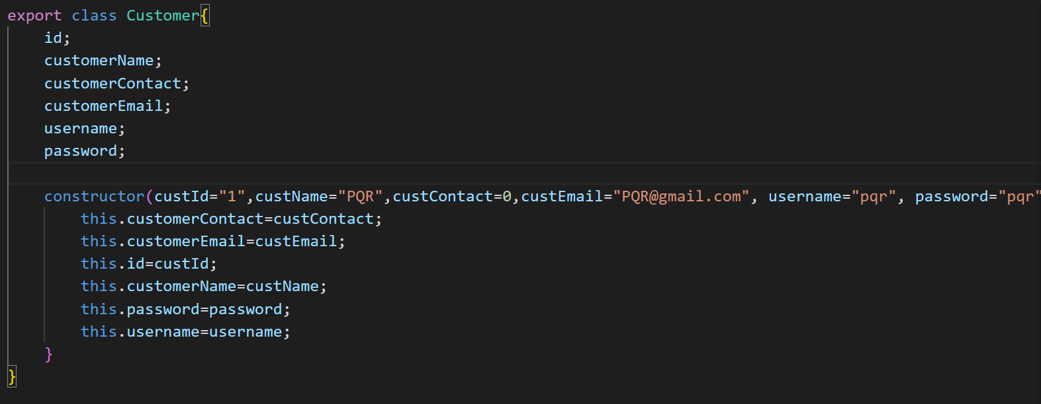
Customer class
Long Cut

Slide 18
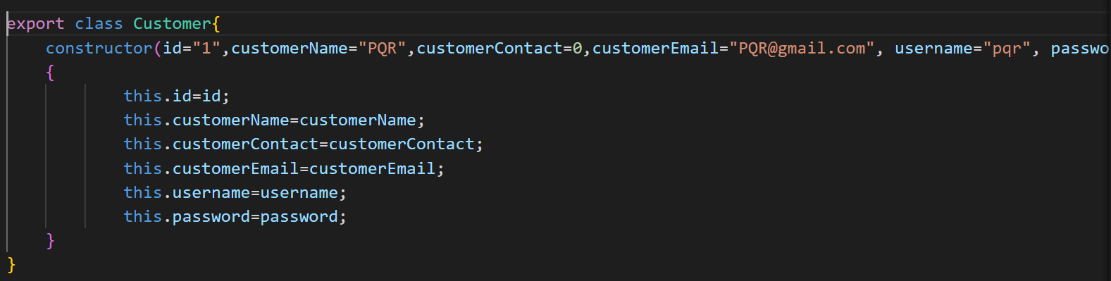
Customer class
Short cut

Slide 19
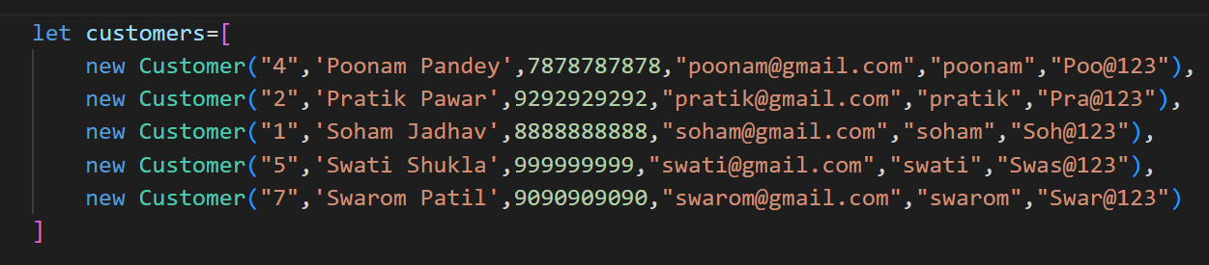
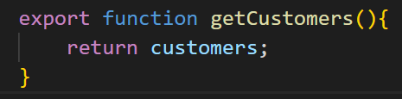
Customer Crud Model
1. Declare Array
2. return this array

Slide 20
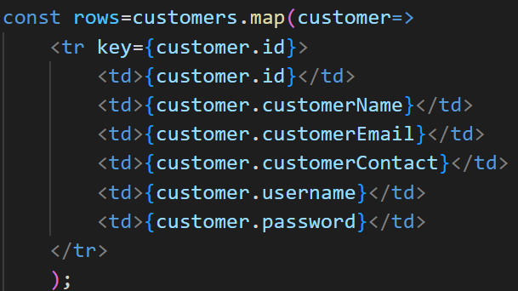
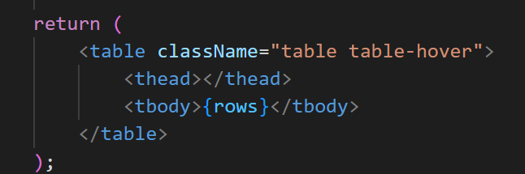
MyCustomer Component
Get Array from Model and map in row
4. return Table

Slide 21
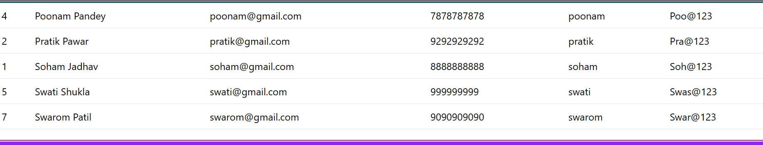
Output

Slide 22
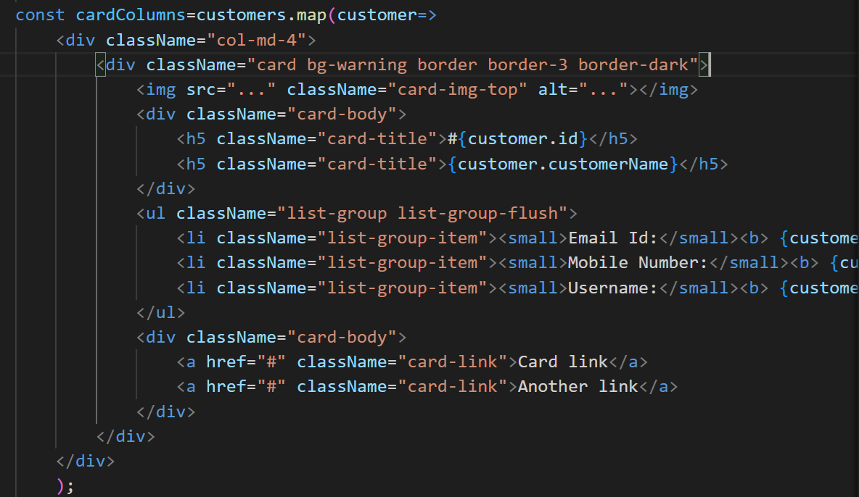
Display Customers in bootstrap card

Slide 23
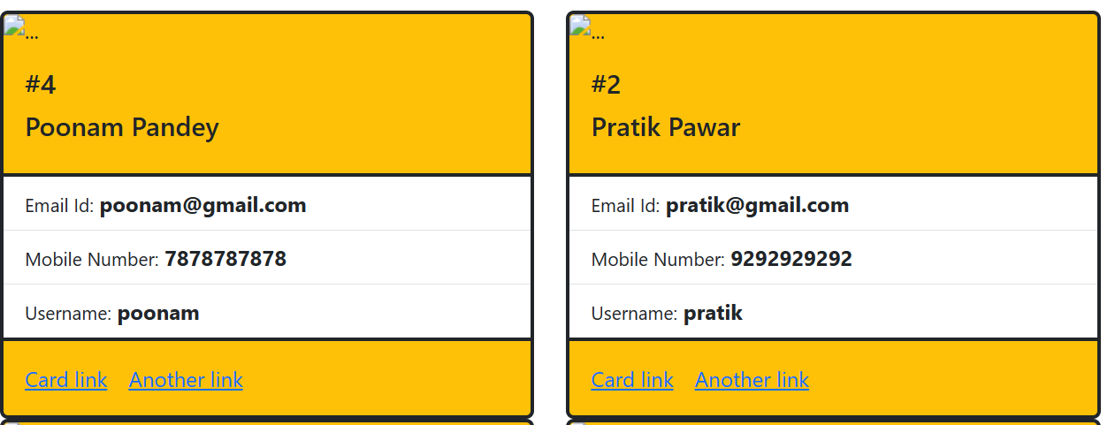
Final output

